Slide 1
Privacy and Security

Slide 2
Someone could listen in
Sending unencrypted communications over the Net is like sending postcards through USPS. Anyone looking at it can read it.
Use encryption – a method scrambles plain text into cyphertext, that can only be read if the reader knows the key
Look for secure protocols like WPA2 for WiFi, PGP for Email, HTTPS for web pages or SFTP for transferring files

Slide 3
Passwords – the strong and the weak
Even if you have an account “you don’t care about”, use a strong password – if you don’t, you are weakening the security on that system for ALL users! If your account can be broken into, the hacker has a foothold in the system to cause further damage to everyone on the system
Never use personal information as a password, like birthdays, nicknames, pet’s names, friends’ names, school names, common words, etc. It’s too easy to guess or find out through Net sources or social engineering
The longer the password the better – the longer it takes to crack. The more kinds of symbols you use (upper case, lower case, digits, punctuation – if allowed), the longer it takes to crack.
Don’t write your password down – instead choose something you can remember – If your favorite book is “Gone with the Wind”, use its initials GWTW plus some digits

Slide 4
Passwords – the strong and the weak
Change your passwords regularly
Don’t use the same password for all your accounts!
Some companies store their password file as plain text. This makes you extra vulnerable because if a hacker gets a copy of the file, they don’t even have to crack it – it’s open for the taking. Companies with good security always encrypt their password files!
Two-step verification – Google will use it if you ask for it
  You start to log in.
  Google sends a short text to your phone
  You enter that text into the system you’re logging into to complete the process

Slide 5
Social engineering
The weak link in any kind of security is the human. 95% of security breaches are caused by human error
People have simply called a company and pretended to be an employee and asked for the password – and been given it!
Scattering infected flash drives around a company parking lot is a way to get the company’s computers infected – people pick them up and try them!
Phishing – fake emails and web pages that fool people into clicking onto web pages that steal information
The most common password is “password” ! Don’t use weak passwords!
Keep your OS and apps up to date, with the latest security updates.

Slide 6
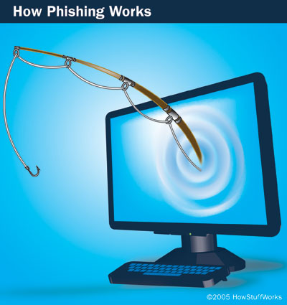
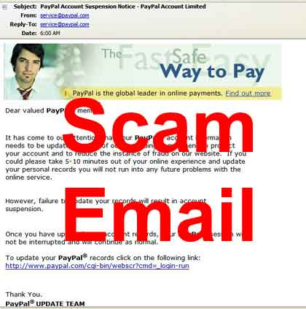
Phishing and Hoaxes
Phishing is a phony communication from a trusted source
Phishing attempts to scam someone into sending vital information
Hoaxes are attempts to scam people into sending money, or join a chain letter
  Nigerian prince
Check it on Snopes.com
Notes:
If you receive an official looking e-mail from your bank saying that there has been a software security breach and to help regain control you need to confirm your username and password, don’t do it. This is one of the most common scams called phishing. The e-mail is made to look very official, with logos and signatures, and many unsuspecting customers have entered their passwords into the return.
Hoaxes often are offers to make millions from a distraught African ex-prince or to help the victims of a hurricane. It is always best to absolutely know who is sending the message before responding.

Slide 7
Sharing means losing control
Getting ALL copies of your data, images, messages deleted from the Net is impossible
Systems that were used to transmit them can keep backups, archives that have a copy of your data
Anyone could download it, even in a minute or two that it was posted
Snapchat photos can be retrieved with the right tool!
Information that you did not mean to be public, that you only sent to a friend, can become public very easily
Information is valuable to companies of all kinds, it IS bought and sold!

Slide 8
“Online is real”
When you apply for a job, very often employers will check your on-line profile to see if you are a good ‘fit’ for the company, if your stated qualifications are supported, if you gossip about co-workers or employers, if you have habits that would affect your job performance
When you apply for college, many admissions offices do the same thing to see if you fit with the college community
Think before you post! Check the facts before you retweet or repost a story! Check with the sender before posting or forwarding emails to you! Set your apps’ privacy settings so you are not sharing everything with everybody!

Slide 9
Malware
“Malicious software” – installed without a user’s knowledge or consent, usually does damage to the computer’s data, spying on users, or control the computer to use it in attacks on other computers
Malware is more common on desktop and server machines. Why?
Mobile computers are newer, with newer OS’s, not much malware has been written yet, most apps come from moderated “app stores”
Virus
Worm
Trojan
Adware
Spyware

Slide 10
Viruses
First form of malware
A program capable of reproducing itself and attaching itself to another file
They try to remain invisible and unknown to the user as long as possible
Originally just executable files on the local machine
More recently attach to document files via macro viruses
Generally have to be given permission to run by the user, unknowingly
You need antivirus software! MS Security Essentials is one good one (now built into Windows 10)
and make sure it is actually running!

Slide 11
Worms
More proactive programs which transmit themselves over a network
don’t need user’s permission to run once they are resident on a computer
first Internet worm in the 90’s, brought down a large part of the young Internet
Can travel vast distances on the Internet in a few seconds
You have to have security software running all the time – you will never be fast enough to prevent a worm from hitting your machine

Slide 12
Trojans
Programs that WANT to get attention so they will be downloaded
All kinds of attractive software – games, calendars, apps
They may or may not actually do what they are advertised for, but they DO infect other files on the computer
Can attach keyloggers to Operating Systems
Make sure you know what you are agreeing to download before you do!

Slide 13
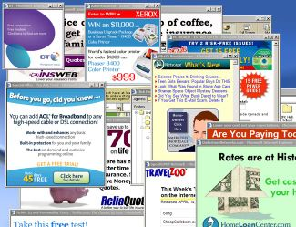
Adware / Pop-ups
Unwanted advertising
Pop-up automatically on top of your windows
Can also contain spyware
Most browsers can prevent them
Pop-up blockers exist as addons to browsers
Notes:
Pop-up windows are the billboards of the Internet.
Some sites use pop-ups to increase the functionality of their site (your account balance may pop up at your bank’s Web site, for example).
There are ways to reduce or eliminate pop-ups. Firefox and Safari have built-in pop-up blockers. Windows includes a Pop-up Manager to Internet Explorer that allows you to selectively block pop-ups.
If you feel you need more protection, you can install anti-pop-up software such as Pop-Up Stopper and Pop-Up Defender.

Slide 14
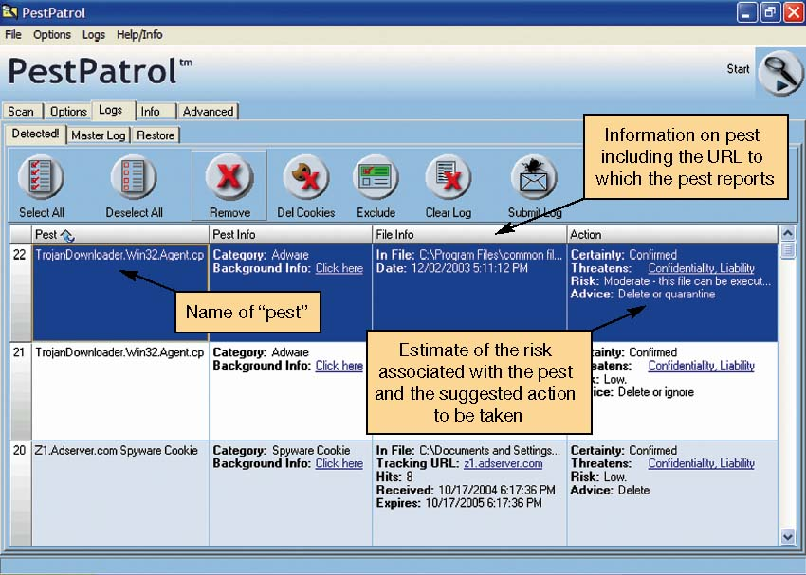
Spyware
Added as a program piggybacked with a requested program
Secretly gathers information, usually about surfing habits
Spyware removal programs are required – Ad-aware or Malwarebytes are good
Notes:
Often a company will offer something for free, like a screensaver or a game. Piggybacked with the program is a hidden spyware program that monitors your browsing and sends this information back to a server.
Spyware removal software is available from many sources, often for free, and can effectively find and destroy these annoyances.

Slide 15
Spyware
Very often comes in from file-sharing, P2P sites
Ties up system resources, can modify browser settings, can spawn popups and other ads
Read the EULA (end user license agreement) for any software you install before you install!

Slide 16
Internet Access Security
A connection that is "always on" is a security risk - turn the computer off when you’re not using it! So the hackers cannot use it.
Keep OS and anti-virus software up to date
USE firewall software
browser security settings
for a local area network (LAN), use NAT on the router - Network Address Translation – makes the whole local network look like ONE IP address to the outside Net
For more privacy on the Net, virtual private network (VPN)

Slide 17
Social Dangers
Cyberbullying
Stalking / harassment
the “Facebook effect” – depression
Identify Theft
Damage to Reputation
Lots of companies profit from selling your information

